Slide 1
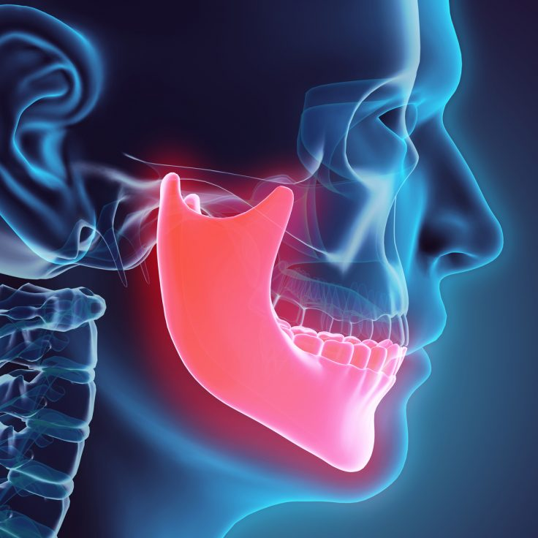
5 easy ways you can relieve jaw pain
By Andre De Oliveira

Slide 2
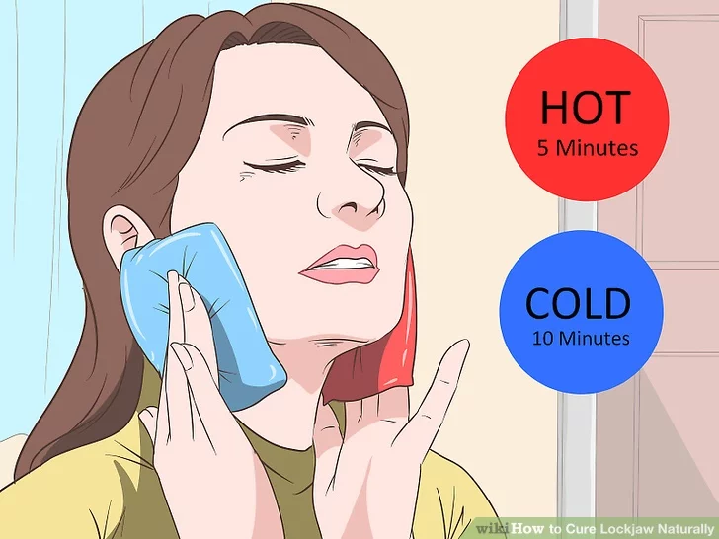
STEP 1: Apply heat or cooling packs
Apply moist heat or cold, whichever feels better, to the joint or muscles that are sore. Heat or ice applications used for 10 to 20 minutes three or four times per day can reduce joint or muscle pain and relax the muscles. For heat, microwave a wet towel for approximately 1 minute or until the towel is warm. You can also wrap a moist hot towel around a hot water bottle to keep it warm longer. For cold, use ice wrapped in a face cloth. Keep ice on the painful area only until you first feel some numbness.

Slide 3
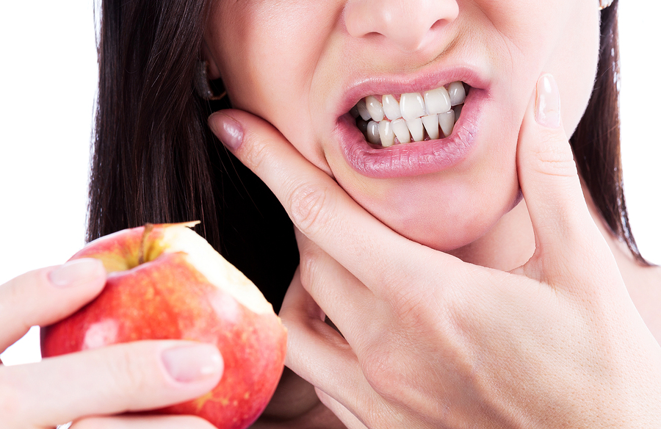
STEP 2: Watch what you eat
Eat a soft pain–free diet. Avoid hard foods, such as French bread and avoid chewy food such as steak and toffees. Cut fruit and steamed vegetables into small pieces. Do not chew gum. Take calcium and magnesium as a supplement, 600mg calcium to 300mg magnesium as well as a multivitamin.

Slide 4
STEP 3: Stop Clenching..
These include teeth clenching or grinding (bruxism), teeth touching or resting together, biting cheeks or lips, tongue pushing against teeth, jaw tensing, biting objects e.g. a pen, other habits. If you do these during work or exercise be aware and modify your habits.
Avoid oral habits that put strain on the jaw muscles and joints!

Slide 5
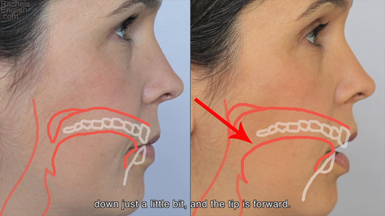
STEP 4: Relax your muscles
Keep your tongue down and relaxed, teeth apart, and jaw muscles relaxed. You must avoid clenching and grinding your teeth. You should closely monitor your jaw positions during the day (waking hours) so that you maintain your jaw in a relaxed, comfortable position. This involves resting the tongue lightly in the floor of the mouth, allowing the teeth to come apart and relaxing the jaw muscles.

Slide 6
STEP 5: Stop making it worse!
Avoid activities that strain your jaw, such as resting your jaw on your hand, excessive singing, or use of musical instruments, if they aggravate the pain and avoid activities that involve wide opening of the jaw (yawning, taking large bites, prolonged dental treatments etc.) for a period of time until the pain has been reduced.
If you are suffering with jaw pain we can help! Call us on: 0207 636 8845 to book a FREE 15 minute discovery session with one of our chartered Physiotherapist. We will be able to diagnose the issue during this session and start a treatment plan with you as soon as possible, to get you on your road to recovery!

