Slide 1
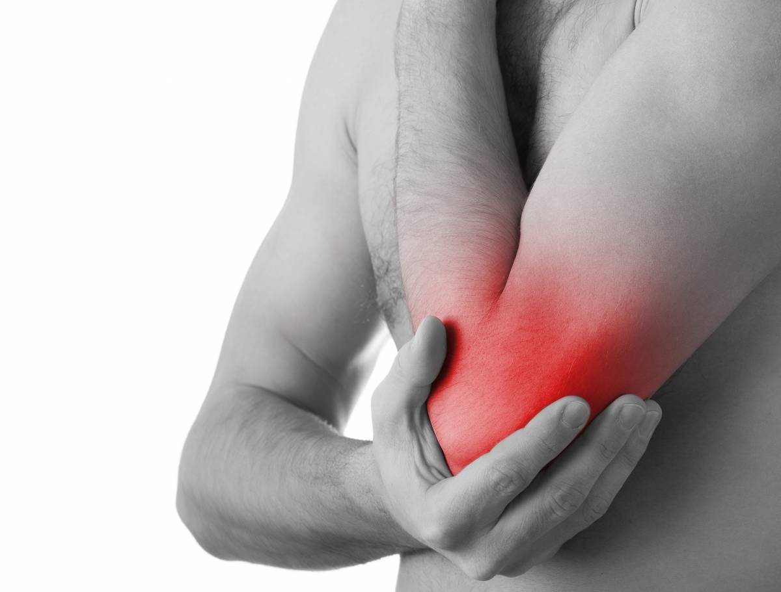
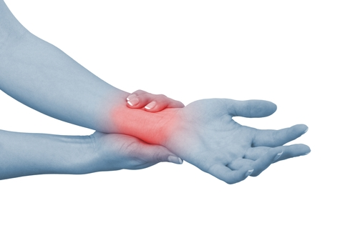
5 ways to combat Wrist and Elbow pain
By Andre De Oliveira

Slide 2
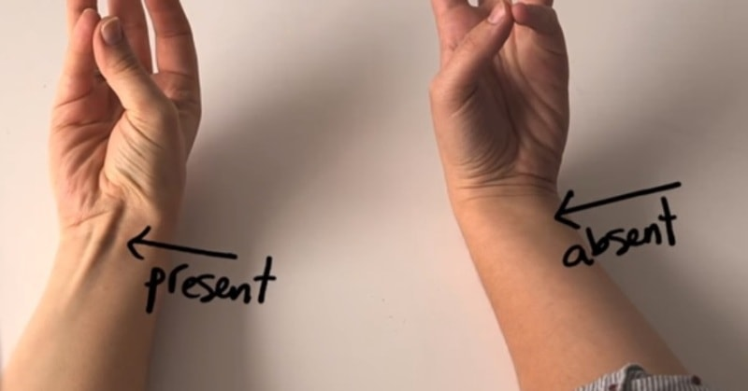
Slacken the thumb
WRIST
Gently squeeze your thumb and palm together so that your little finger and thumb are touching. Hold at least two minutes.
If you are treating Carpal Tunnel Syndrome, keep your wrist straight. A bent wrist could bring on numbness or tingling.

Slide 3
Slacken and stretch the forearm in both directions
For your wrist gently twist your palm so that your thumb faces down. This will release tension in your elbow and wrist. Hold at least two minutes. Then twist the arm the other way and hold for two minutes.
Perform these exercises five times a day until the pain goes away. Remember, these exercises should not hurt, so perform them gently. If they do hurt, feel free to book a free 15 evaluation with us and we can help.
Similarly, for elbow pain stretching out the muscles of the forearm can offer some relief. Simply straighten your elbow out with the palm of your hand facing the floor, and gently pull your fingers toward the underside of your wrist. You should feel a stretch along the back of your forearm. Hold it for 30 seconds. Then flip your forearm over, with your palm facing the ceiling, and push your fingers toward the floor. Hold for 30 seconds.

Slide 4
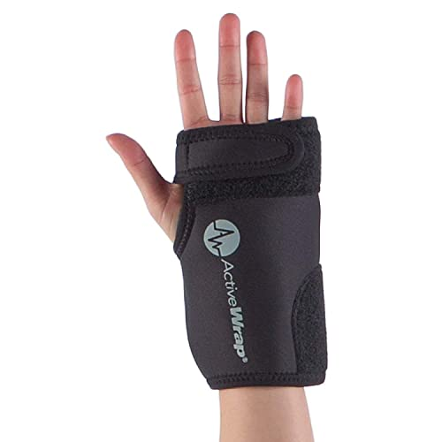
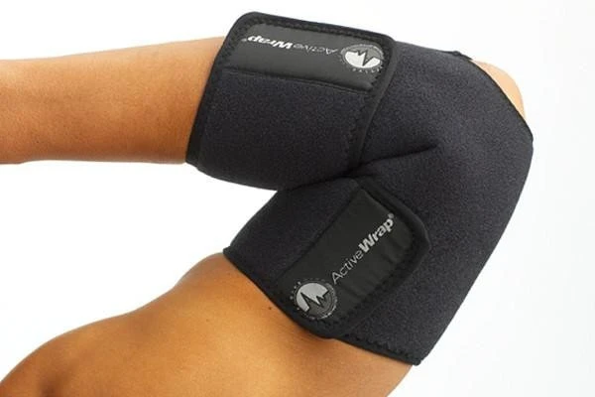
Apply heat!
Use a heating pad on your hands, wrists, and forearms. Do this once or twice a day for at least 20 minutes. Continue until your symptoms subside.

Slide 5
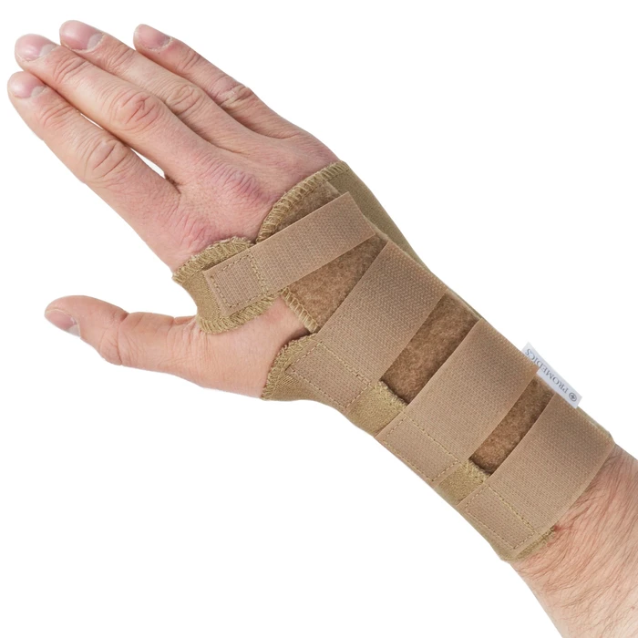
Wear a wrist or elbow brace at night to keep your wrist straight
The majority of wrist/elbow pain and injury are often worse at night, this is because most people sleep with a bent wrist or arm. This position will put pressure on the median nerve all night.
Wearing a wrist or elbow brace at night will help keep the affected areas straightened, alleviating pain and aiding in healing.

Slide 6
REST!
ELBOW
Stop overuse of the muscle group you suspect is behind your elbow pain. For example, if you have a hobby or project that requires repetitive wrist or elbow flexing or extending, you may be overusing the muscles and tendons of the forearm that connect to the elbow or wrist.
Minimize repetitive strain on your wrist or elbow to allow time for the healing process to begin

